Slide 1
Machine Learning Class 4
Aqib Ahmed

Slide 2
What do we have in here for today?
Support Vector Machines
K Means clustering
Random Forest

Slide 3
Let’s talk about SVM - Support Vector Machine is a classifier that finds an optimal hyperplane that maximizes margin between two classes.

Slide 4
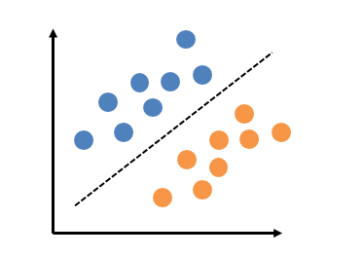
Points to remember
It is a classifier algorithm
Can be used be higher dimensions

Slide 5
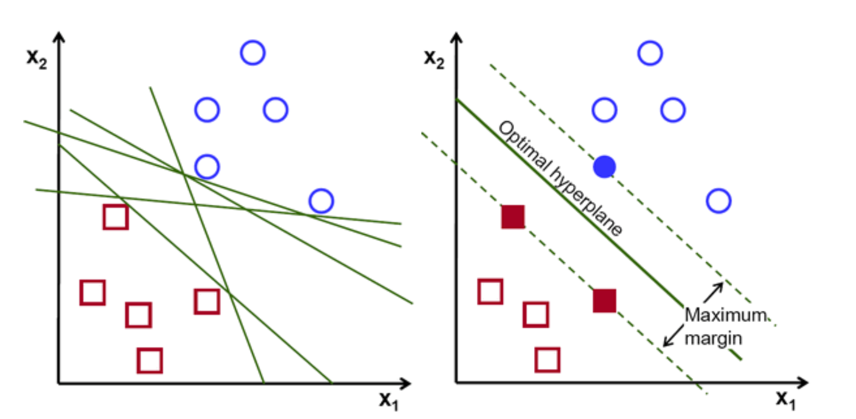
How SVM works

Slide 6
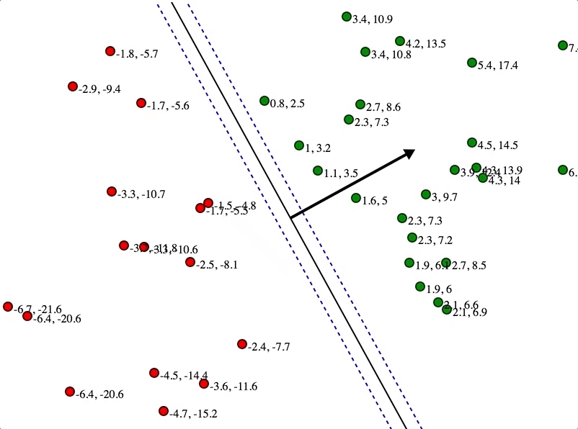
How SVM works

Slide 7
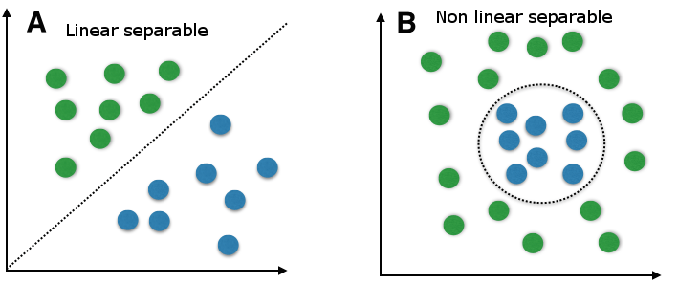
What if we have a non linear data?

Slide 8
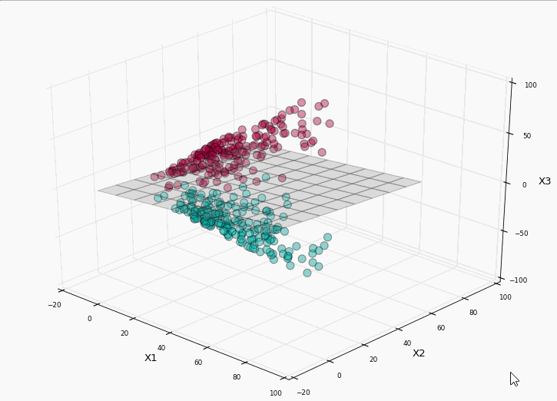

Kernel Trick : Kernel trick separates the data which is non linearly separable in N dimensions

Slide 9
Let’s code SVM!

Slide 10
Let’s talk about Random Forest - It is an ensemble tree based algorithm.The random forest classifier is a set of decision trees from randomly selected set of training set.

Slide 11

BEN - THE BOSS

Slide 12
Random Forest
It is an ensemble algorithm which uses tree based learning. It uses set of decision trees and aggregates results in order to decide to final outcome

Slide 13
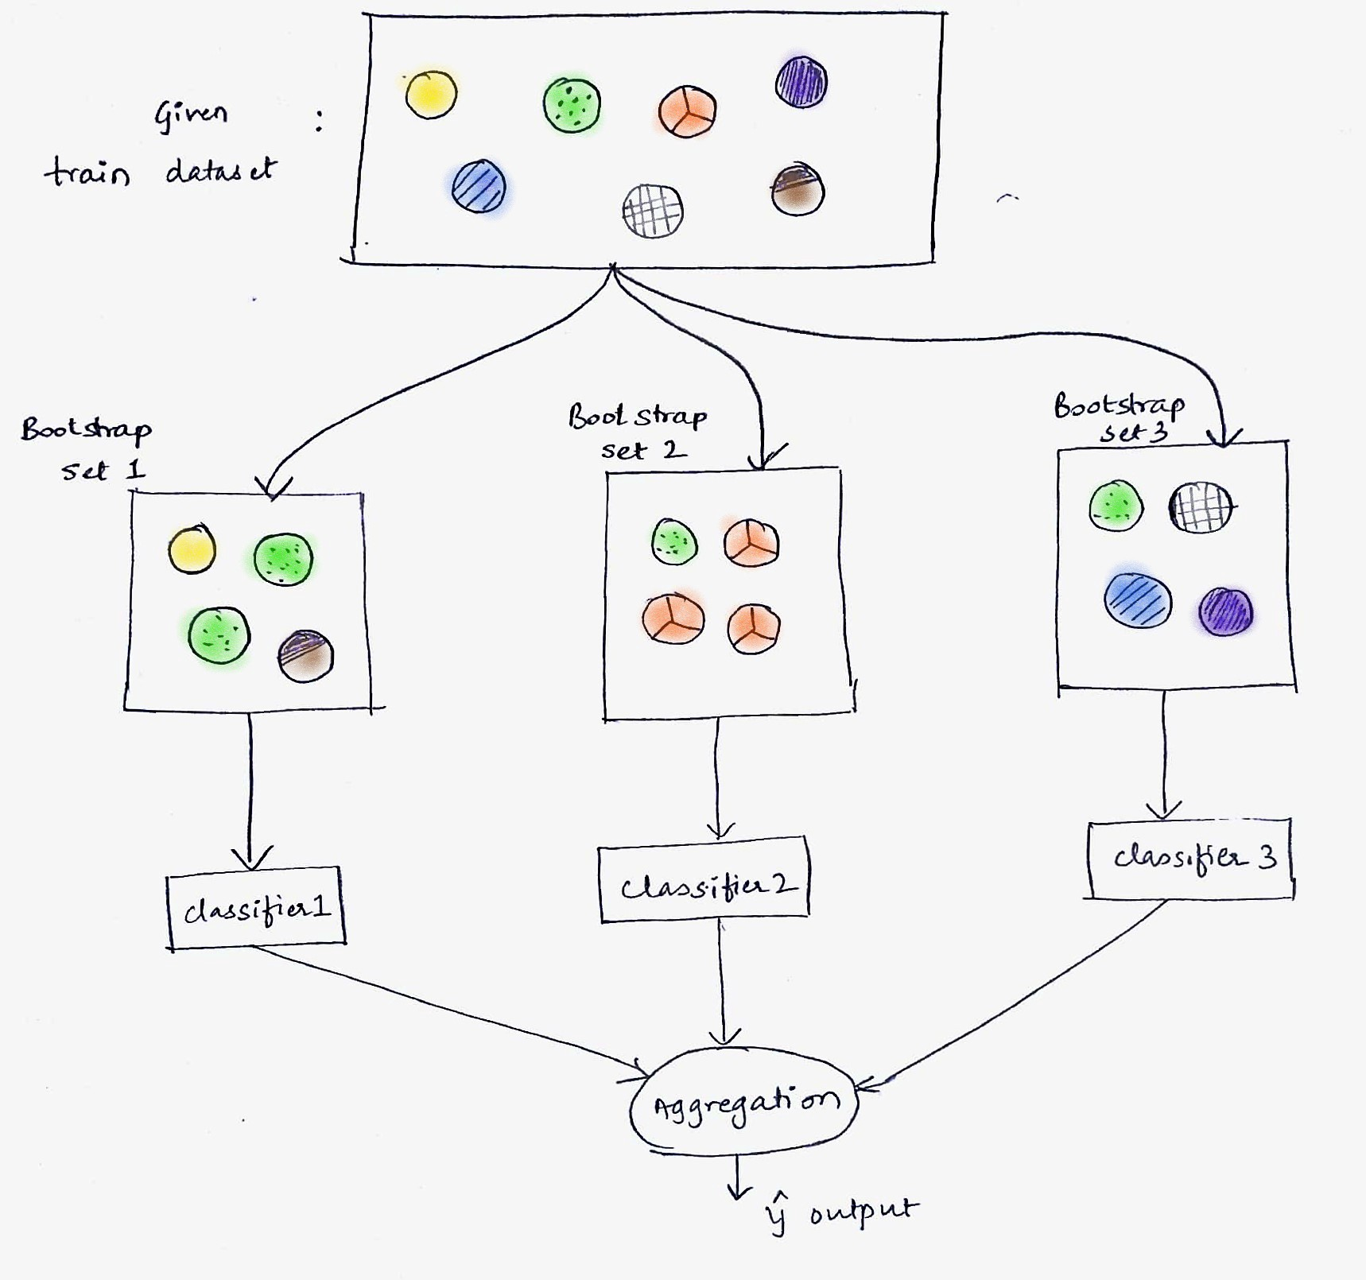
Bagging and Bootstrap Aggregation

Slide 14
Bootstrap Aggregation
Bootstrap aggregation also known as Bagging is a machine learning ensemble algorithm

Slide 15
Let’s code Random Forest!

Slide 16

Thanks!

